Slide 1
Workshop

Slide 2
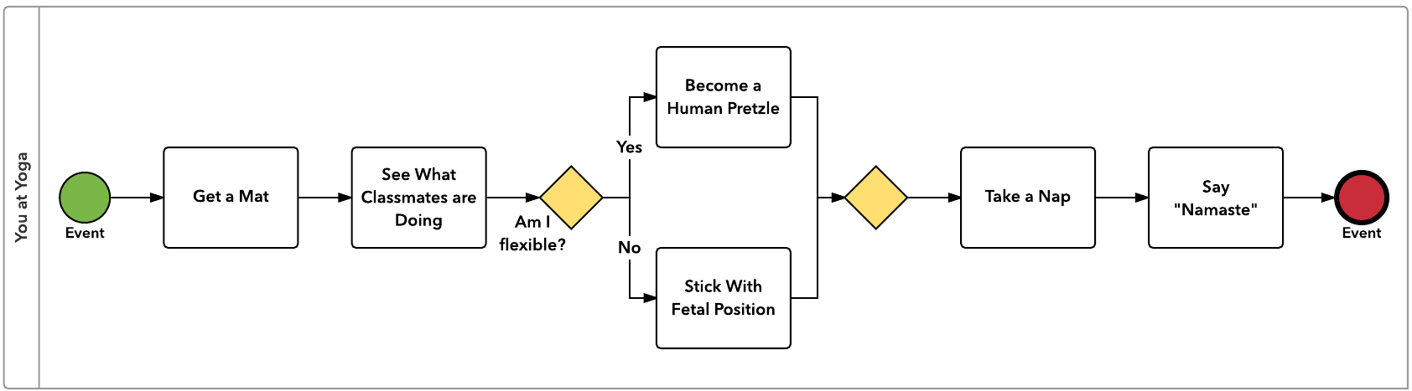
Notation recap

Slide 3

Big Smiles Dental Surgery
Big Smiles Dental Surgery has a new system, which was designed to manage patient appointments and records.
The current receptionists claim that they can no longer print reminders to their patients and this is causing an increase in the number of ‘no shows’.
This function was apparently based on a mail-merge facility from the patient record database into Word.
What do you think has happened?
Is this really a ‘system’ problem or is something else afoot?
What else would you do to find out more?

Slide 4
Tools to draw a BPMN diagram
MS Visio
Lucidchart
Any others?

Slide 5
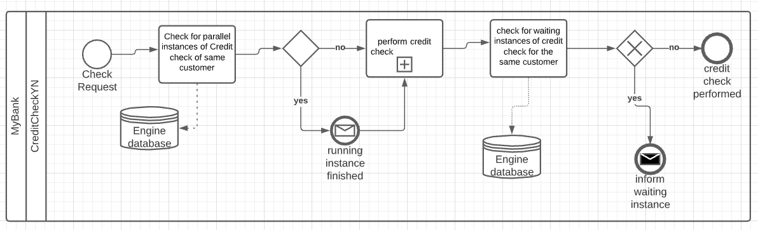
BPMN diagram simple example
Process of a credit check.

Slide 6
Big Smiles Dental Surgery
Big Smiles Dental Surgery has a new system, which was designed to manage patient appointments and records.
The current receptionists claim that they can no longer print reminders to their patients and this is causing an increase in the number of ‘no shows’.
This function was apparently based on a mail-merge facility from the patient record database into Word.
Open lucidchart and create a BPMN diagram to showcase the current system

Slide 7
Task 1
Take 15 minutes and create a BPMN diagram in your groups.
Use either software or pen and paper to draw it.
The BPMN will be about the process to order a pizza in a restaurant. It consists of 2 lanes, one for the waiter and for the cook and another pool for the customer.
Swap your diagram with the group next to you.
How would you mark it?

Slide 8
Task 2
Take 15 minutes and create a BPMN diagram in your groups.
Use either software or pen and paper to draw it.
The BPMN will be about the process of booking travel via Virgin holidays agent service. It consists of 2 lanes, one for the agent and for the admin department and another pool for the customer.
Swap your diagram with the group next to you.
How would you mark it?

Slide 9
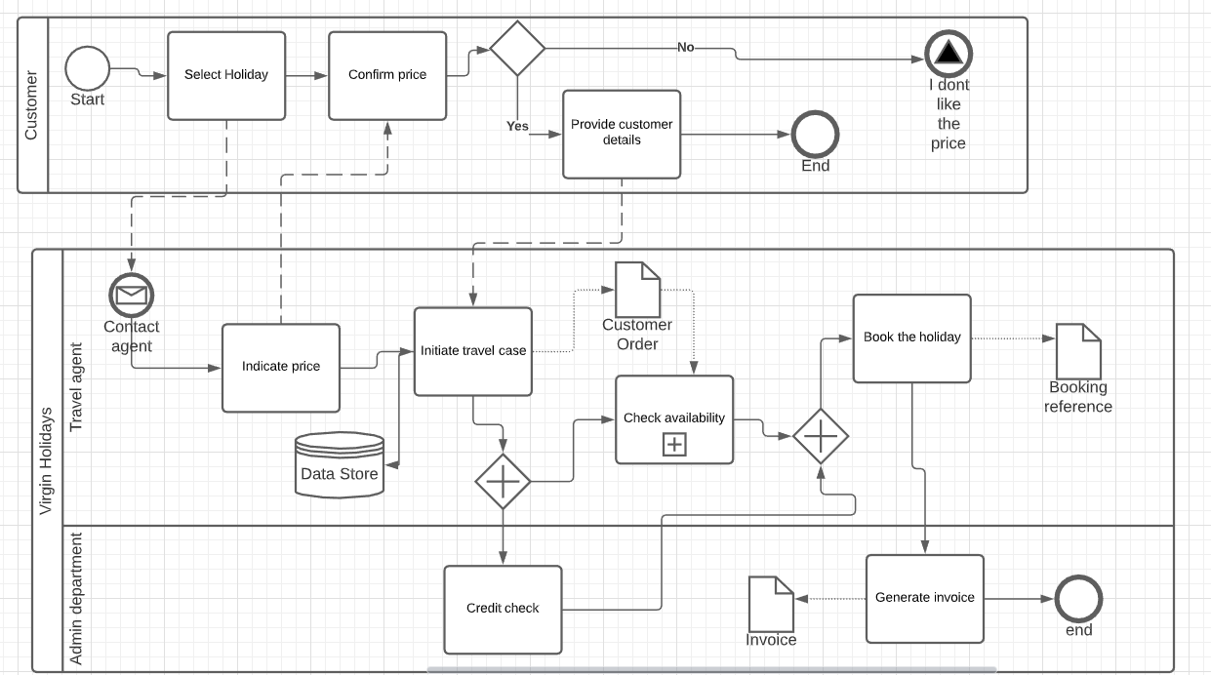
Suggested answer to Task 2

